Slide 1
Automatic Washroom Light
(Motion Detector Using Arduino and PIR Sensor)
Name : Shekhar Raj Suryavanshi
Roll no. : 1901CS54

Slide 2
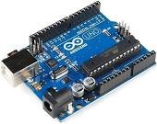
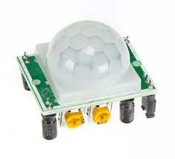
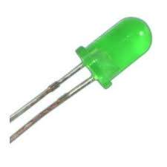
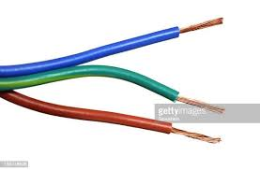
Components Required
1.Arduino UNO
2.PIR Sensor
3.LED
4.Wires

Slide 3
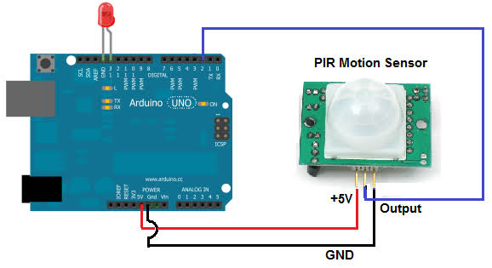
CIRCUIT DIAGRAM

Slide 4
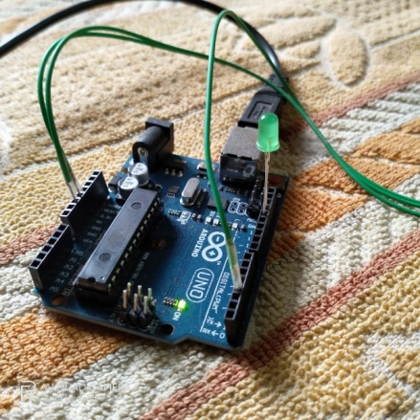
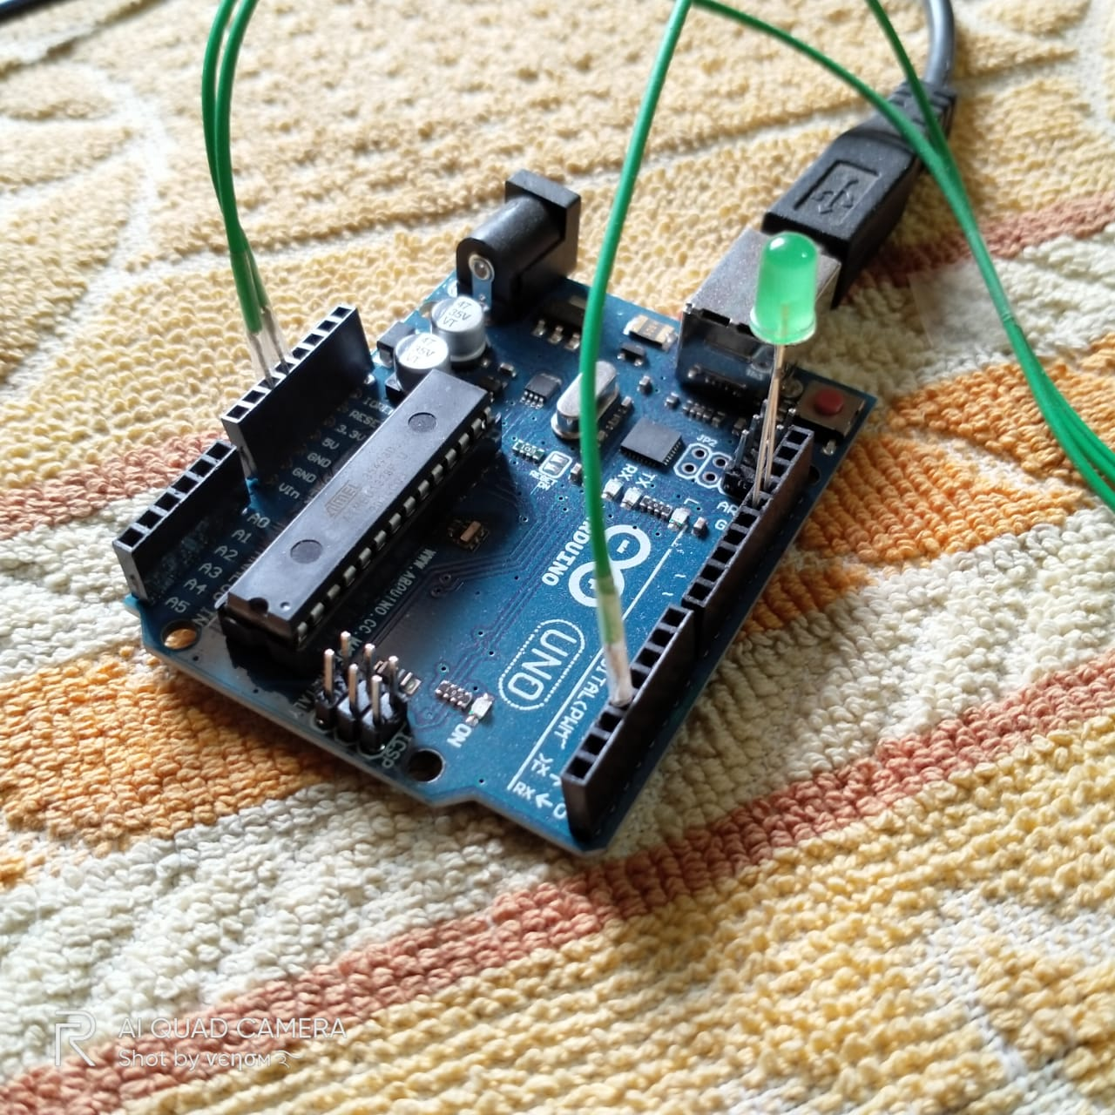
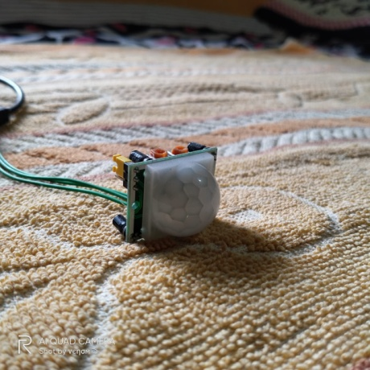
Arduino
PIR Sensor
Connections

Slide 5
WORKING
The circuit is constructed as shown in diagram.
When any object comes in range of PIR motion sensor. It senses the motion and outputs a HIGH signal. The output pin of PIR sensor is connected to Arduino in digital pin no. 3. Arduino reads input from this pin no. 3. If input is HIGH, it makes the digital pin no. 13 to HIGH which turns ON the LED connected to this pin and after the delay time is over(30 sec set in code) is over or no motion detected. Arduino makes the pin no. 13 to LOW state which turns OFF the LED.

Slide 6
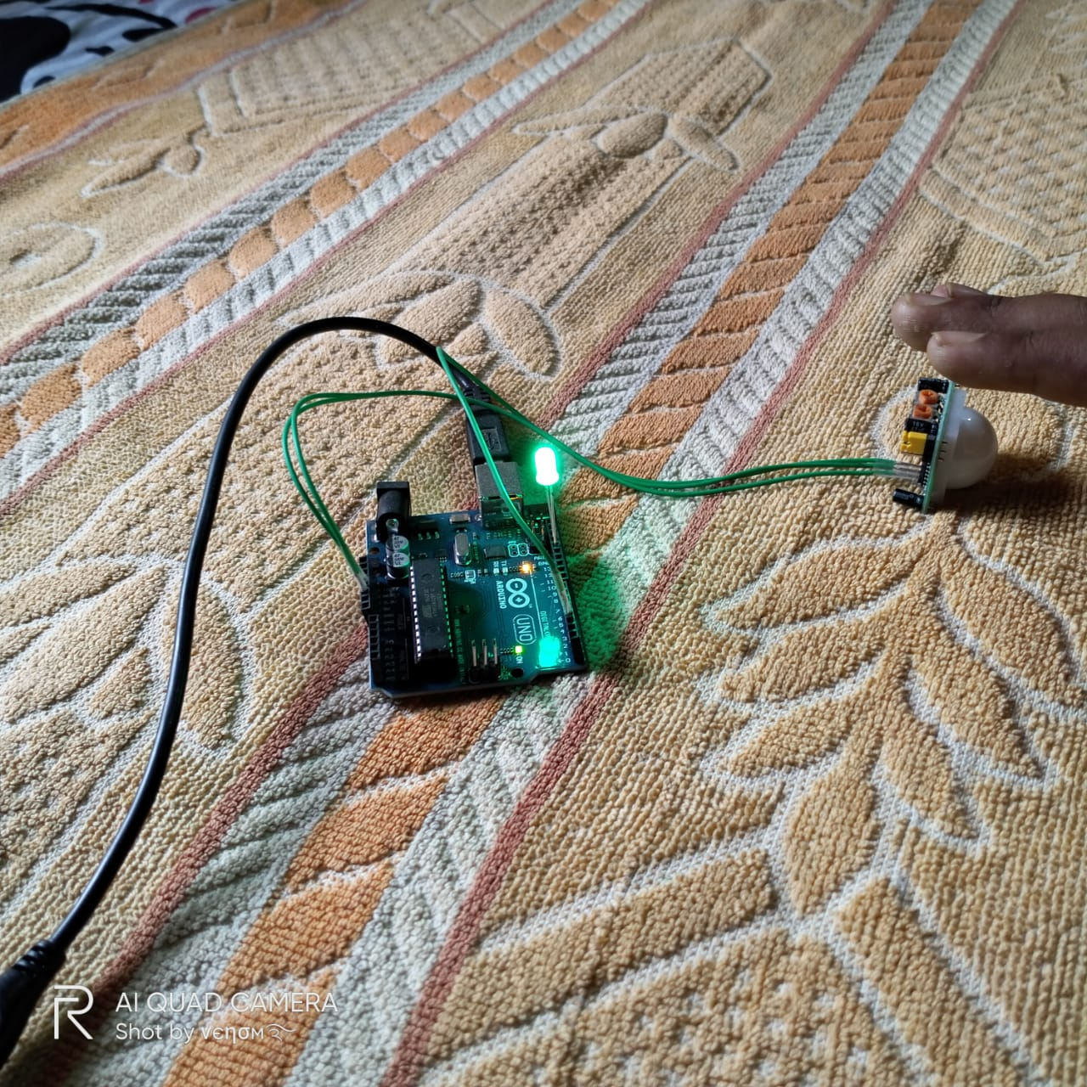
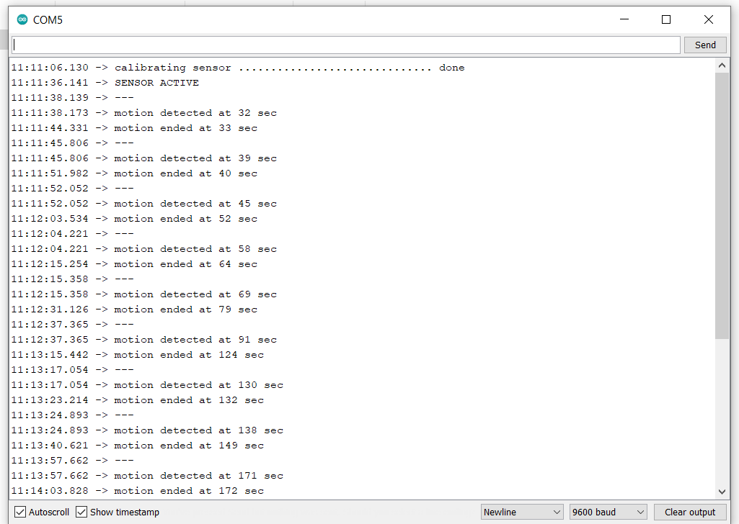
LED is Turned ON when there is a hand or motion in front of PIR sensor
Serial Monitor Output screen
(Showing the motion detecting and ending time)

Slide 7
THANK YOU

